Slide 1
HOSTEL MANAGEMENT
SYSTEM
UNDER THE GUIDANCE OF:
KANU SIR
PREPARED BY:
19BCA014 – OM PATEL
19BCA017 – DEV PATEL
19BCA024 – SNEH GOSWAMI

Slide 2
INTRODUCTION:
The “HOSTEL MANAGEMENT SYSTEM” is an application developed for managing various activities in the hostel.
This project deals with the problems of managing a hostel and avoids the problems which occur when carried manually. This application is useful to avoid the manual data entry and is easy to access the data about the hostels.
Thereby the management of hostel becomes easier to maintain and access. The application is provided with easily understandable and user-friendly GUI.
The main objectives of the project are to reduce the human effort and processing time in maintaining the student and staff information, accessing the data more easily.

Slide 3
PROJECT OVERVIEW:
Hostel Management System is designed for better interaction between Admin and Users.
This system will enable the Hostel in managing its activities, ensuring data access when necessary, and safely storing data.
Hostel Management Script is developed in PHP with MySQL database. It has admin and user roles. Admin has all the privileges to manage courses, rooms, student registration, manage students, and user access logs. Users have options to manage their profile, book hostels, manage rooms, etc.
Hostel Management Script has the following features:
Dashboard
Admin, User login
Admin panel
Dashboard
Manage Courses
Rooms
Student Registration
User Access Logs
User Panel
Book Hostel
Room Details
My Profile
Access Log
Change Password
Manage Students

Slide 4
EXISTING SYSTEM
The existing system is manual based and need lot of efforts and consume enough time. In the existing system we can apply for the hostels online but the allotment processes are done manually. It may lead to corruption in the allocation process as well as hostel fee calculation.
Disadvantages are
More human power
More strength and manual labor needed
Low Security
Difficulty to handle
Difficulty updating data
Record keeping is difficult

Slide 5
PROJECT OBJECTIVE:
The objective of our hostel management system is to overcome the drawbacks which are faced in existing system.
We can improve the efficiency of the system such as less human error, manual labor can be reduced, high security, Easy to handle, Easy data updating & record keeping

Slide 6
REQUIREMENT SPECIFICATION:
Minimum Hardware Requirements:
Processor : p4/dual core
Ram : 512MB to 5GB
Hard disk : 3 GB
Minimum software requirement:
OS : Microsoft Windows XP or later/vista/7/8/and Linux
Browser : Mozilla Firefox, google chrome, opera

Slide 7
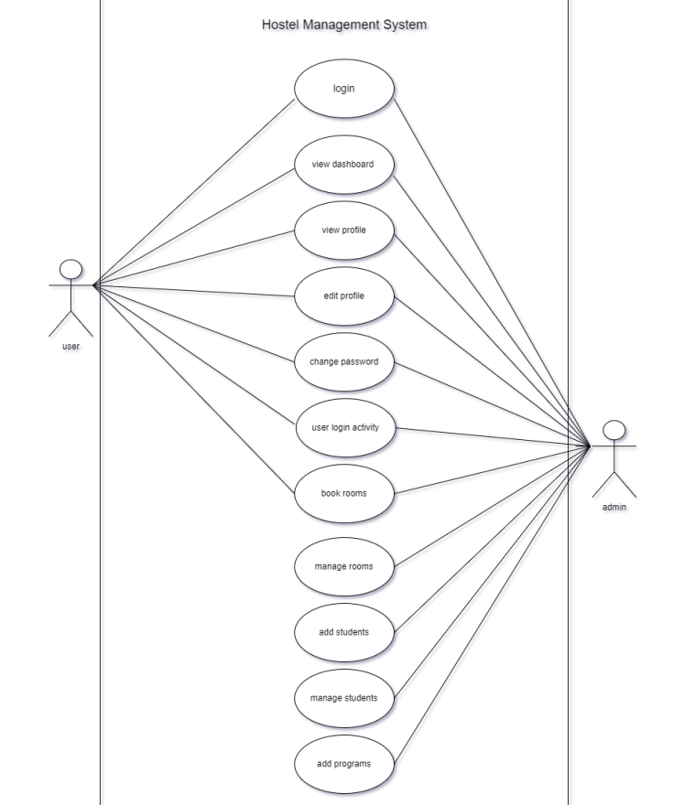
USE CASE DIAGRAM:

Slide 8
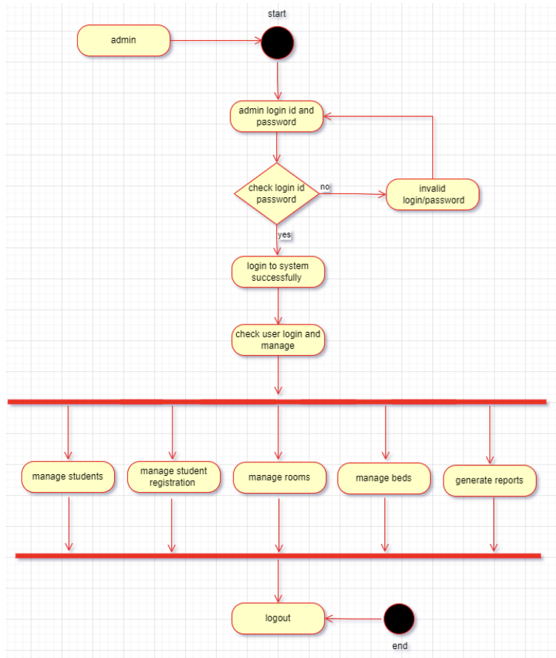
ACTIVITY DIAGRAM: ADMIN

Slide 9
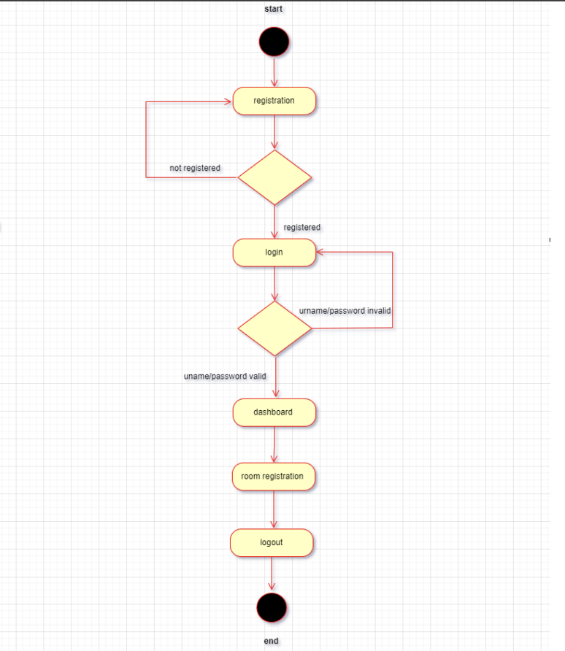
ACTIVITY DIAGRAM: USER

Slide 10
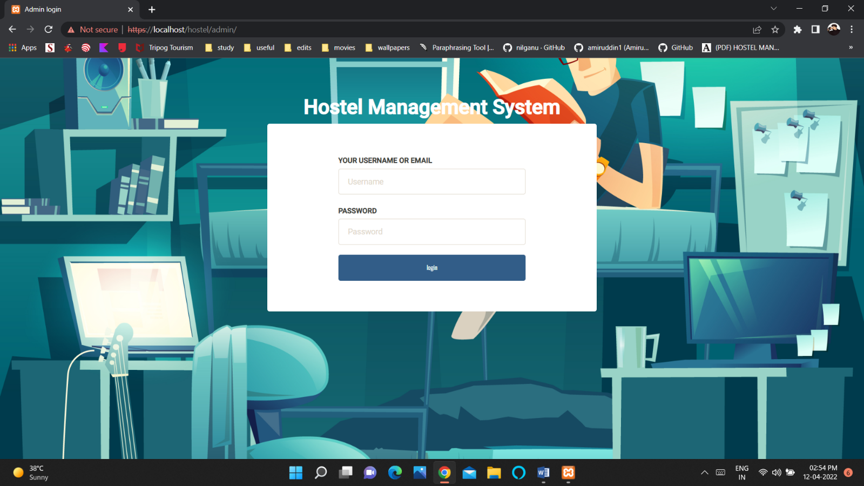
ADMIN’S LOGIN PAGE:

Slide 11
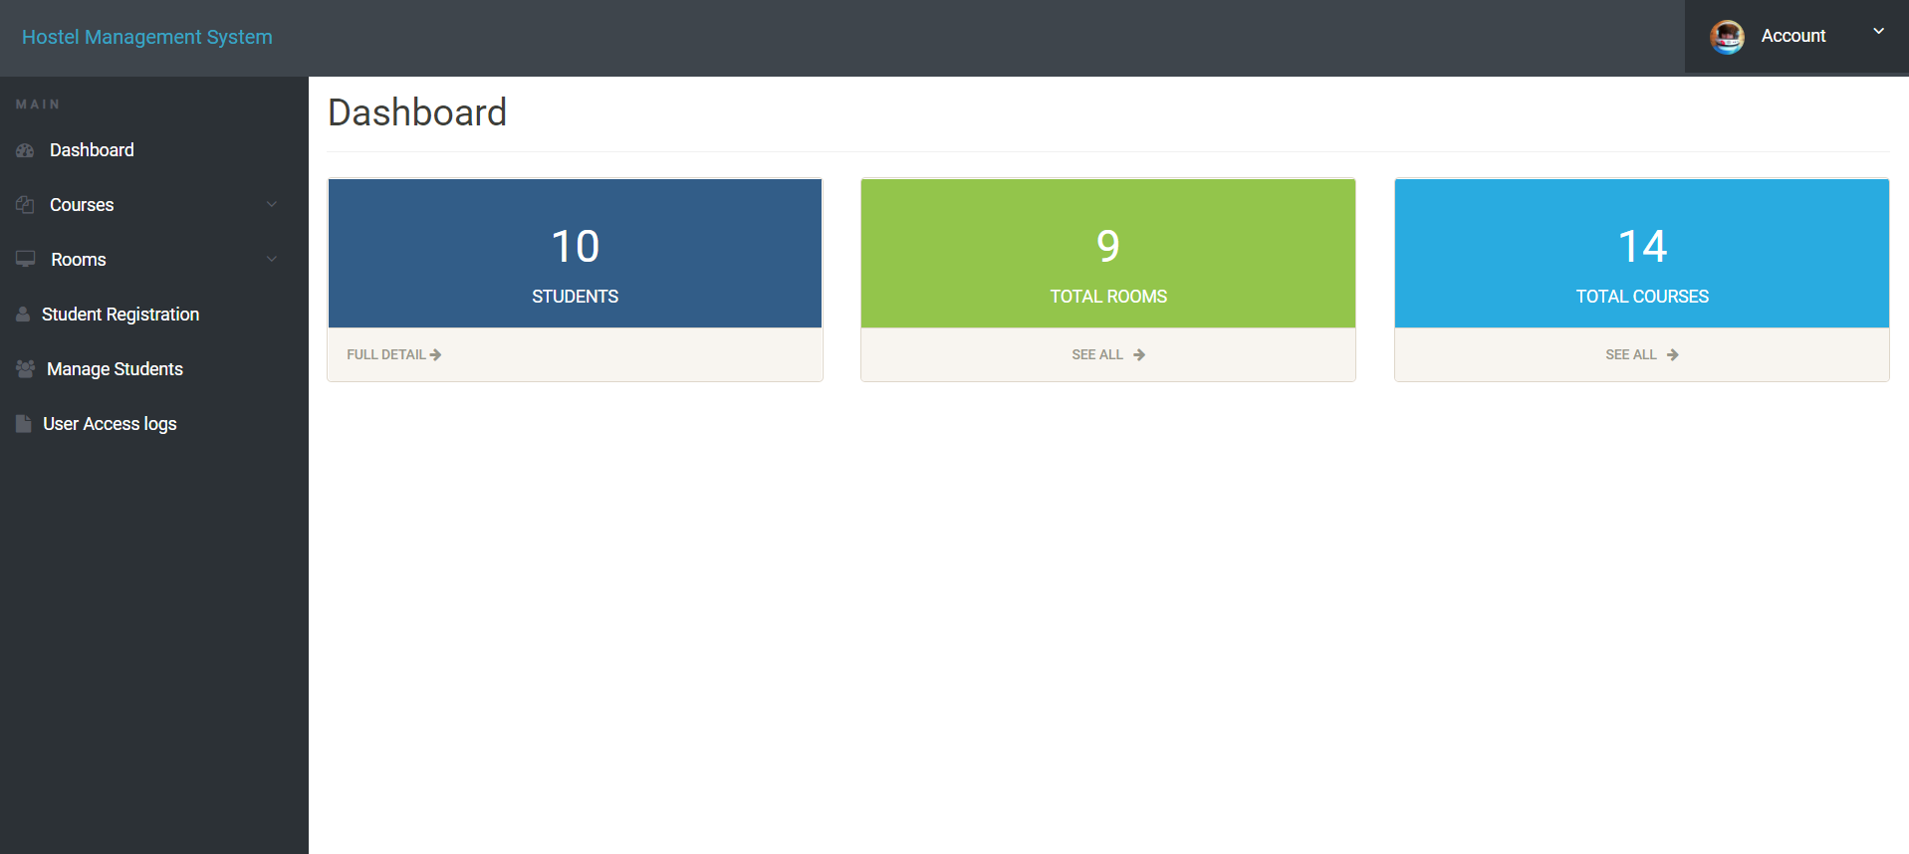
ADMIN’S DASHBOARD:

Slide 12
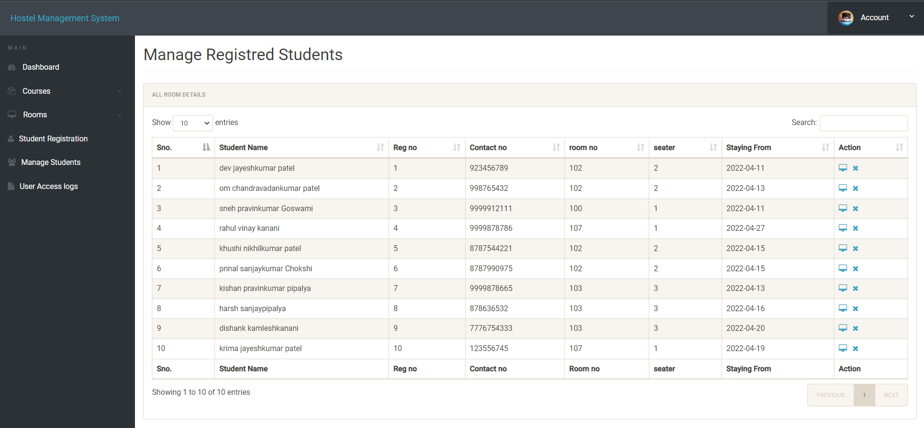
LIST OF REGISTERED STUDENTS:

Slide 13
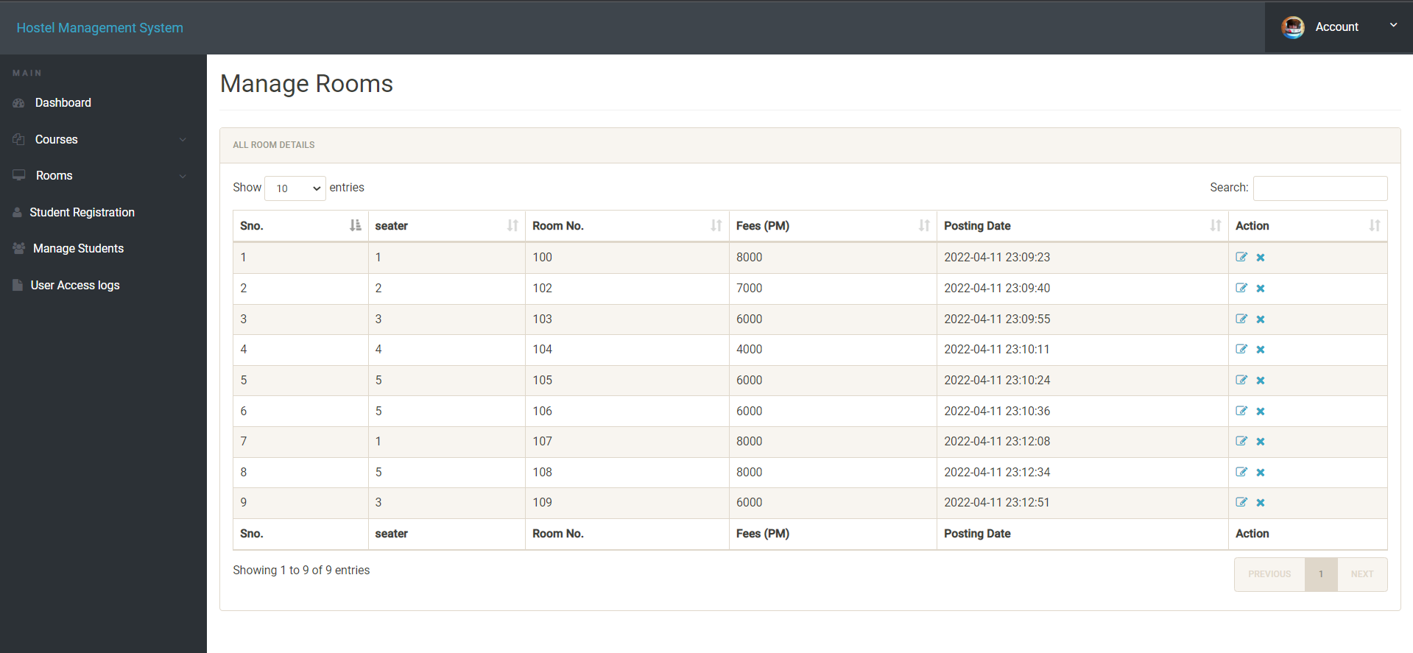
NUMBER OF ROOMS AVAILABLE:

Slide 14
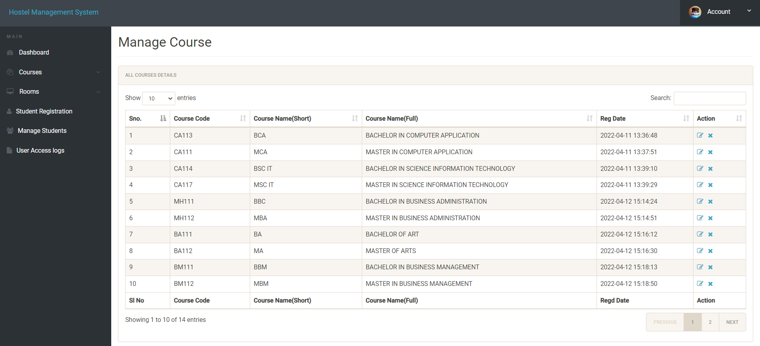
LIST OF PROGRAMS:

Slide 15
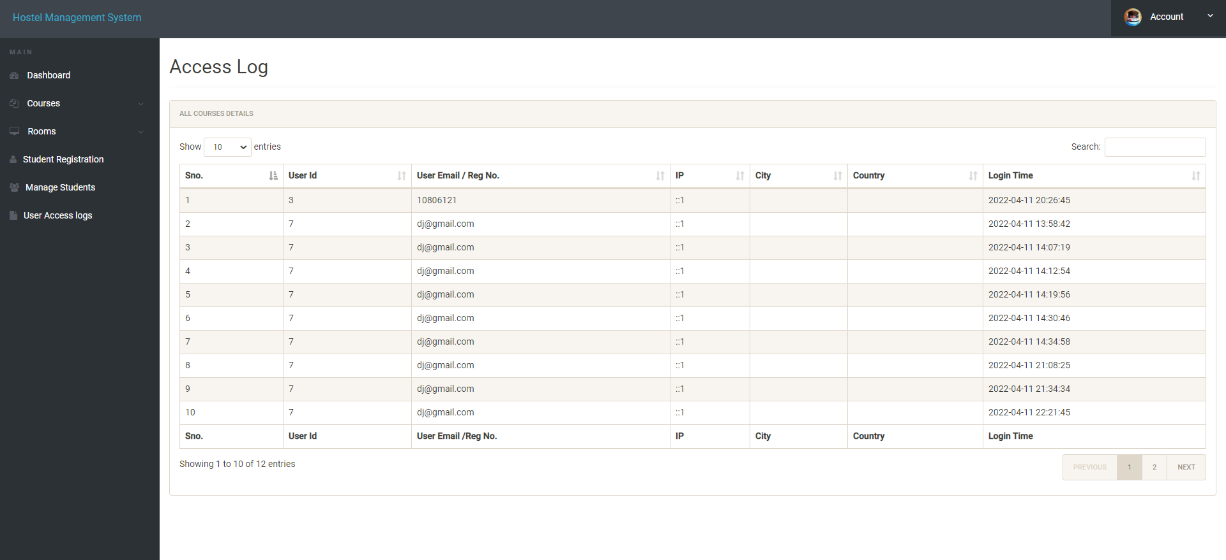
ADMIN ACCESS LOG:

Slide 16
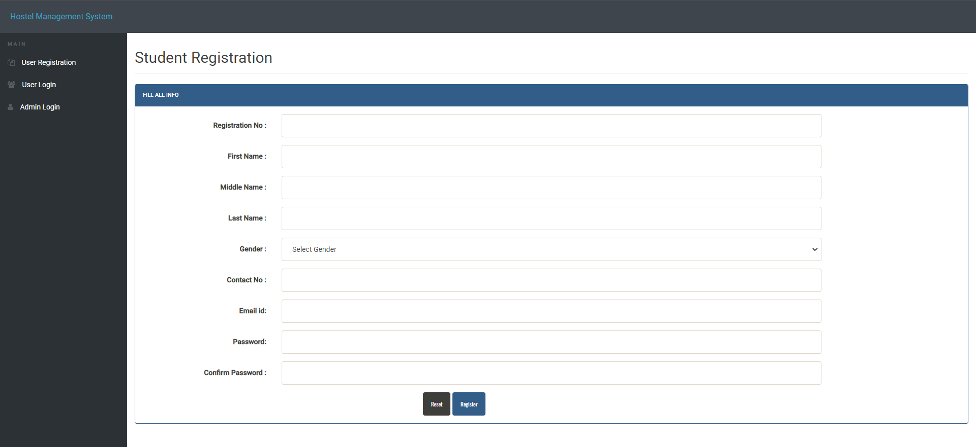
STUDENTS REGISTRATION :

Slide 17
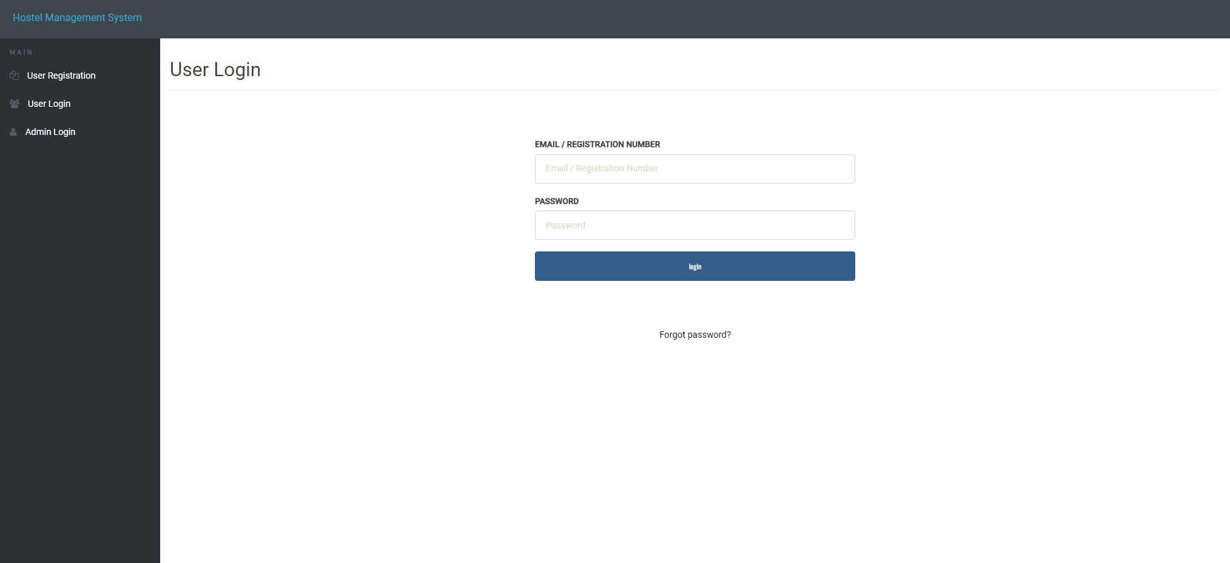
USER’S LOGIN PAGE:

Slide 18
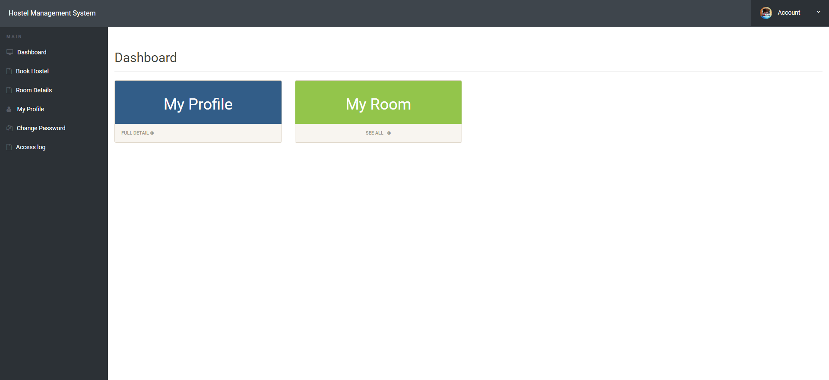
USER’S DASHBOARD:

Slide 19
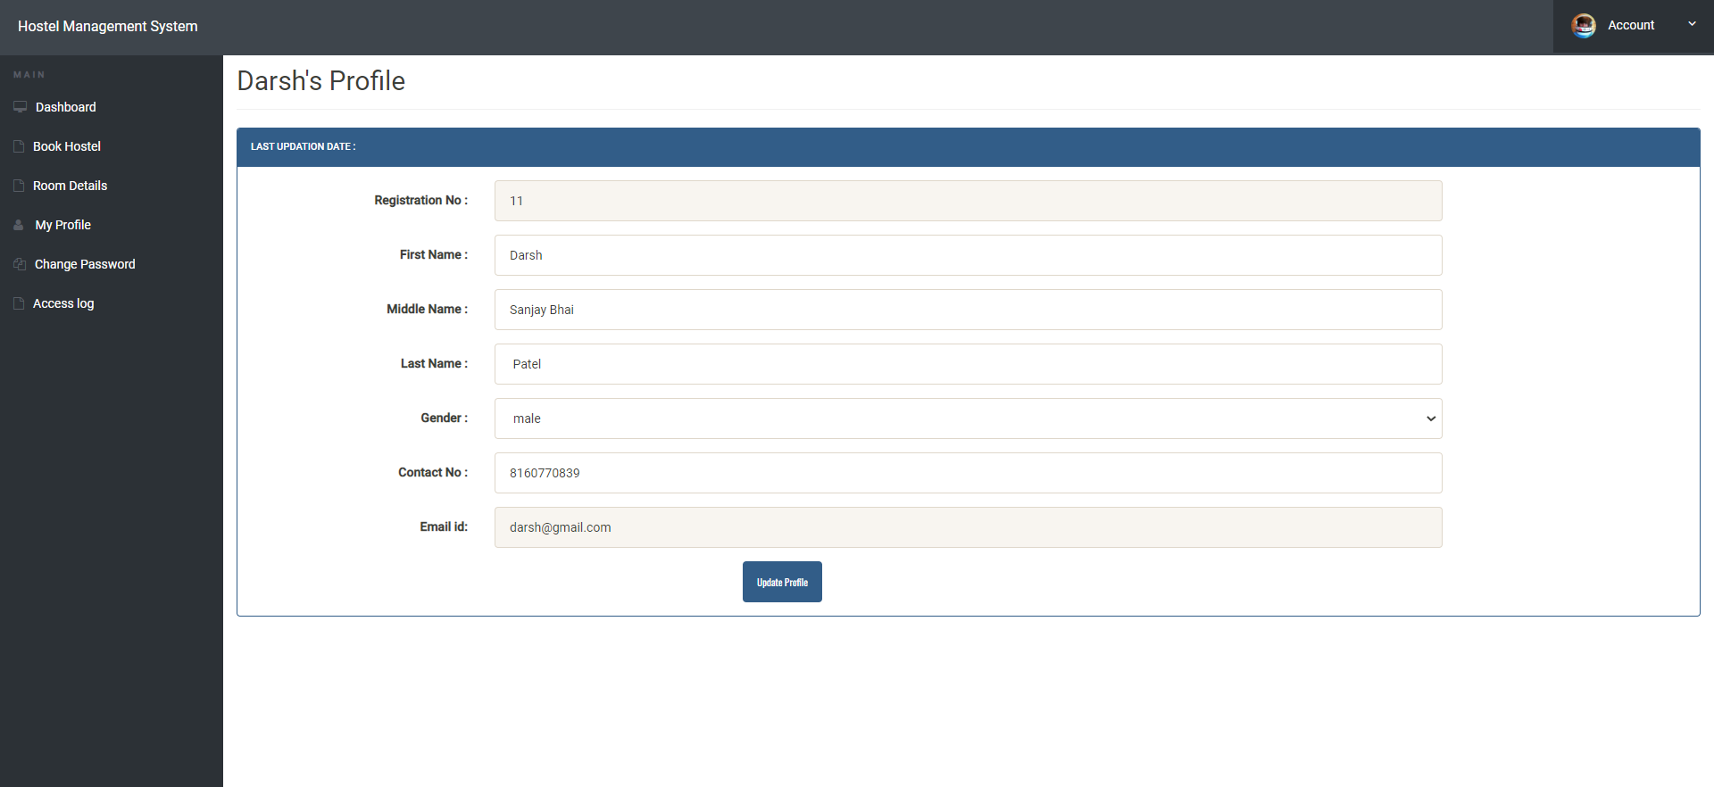
USER’S PROFILE:

Slide 20
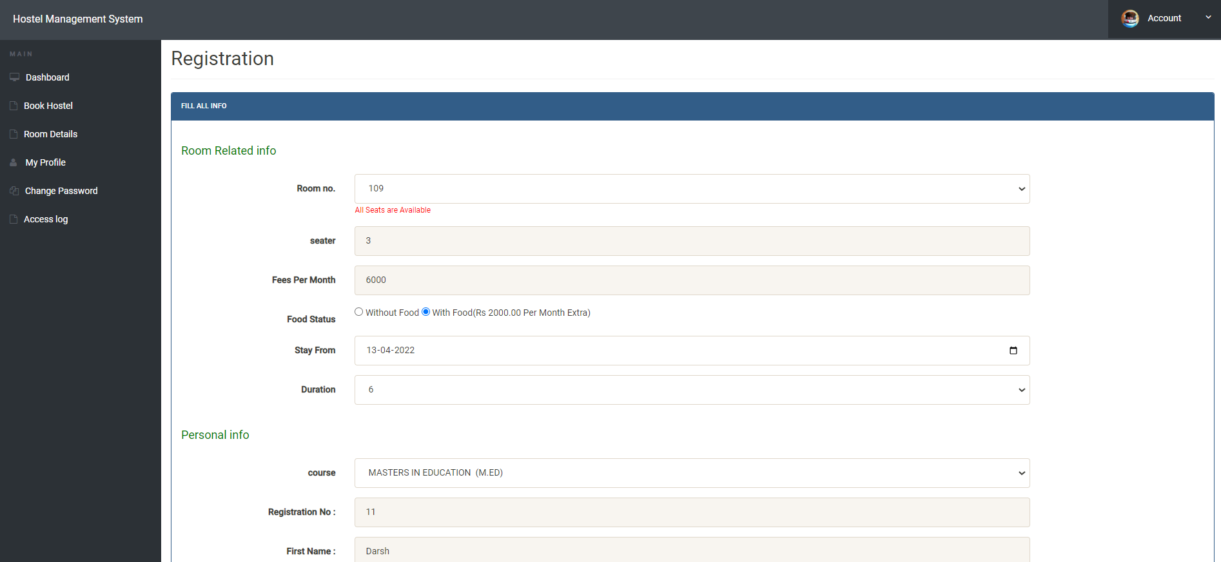
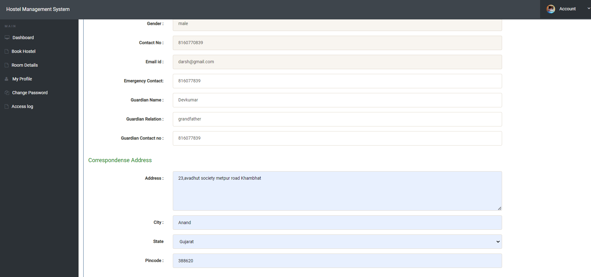
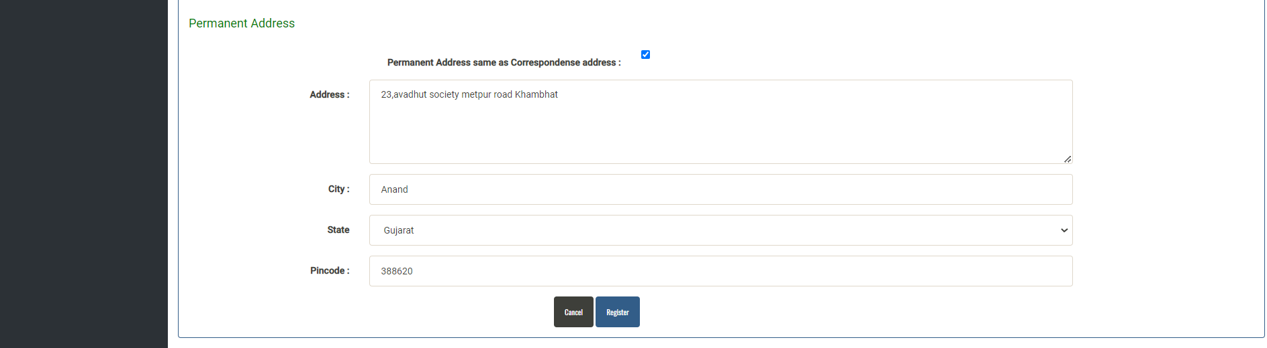
BOOK ROOMS:

Slide 21
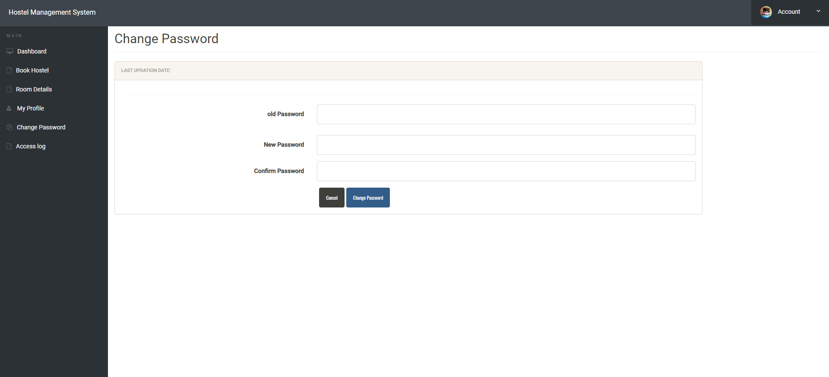
RESET PASSWORD :

Slide 22
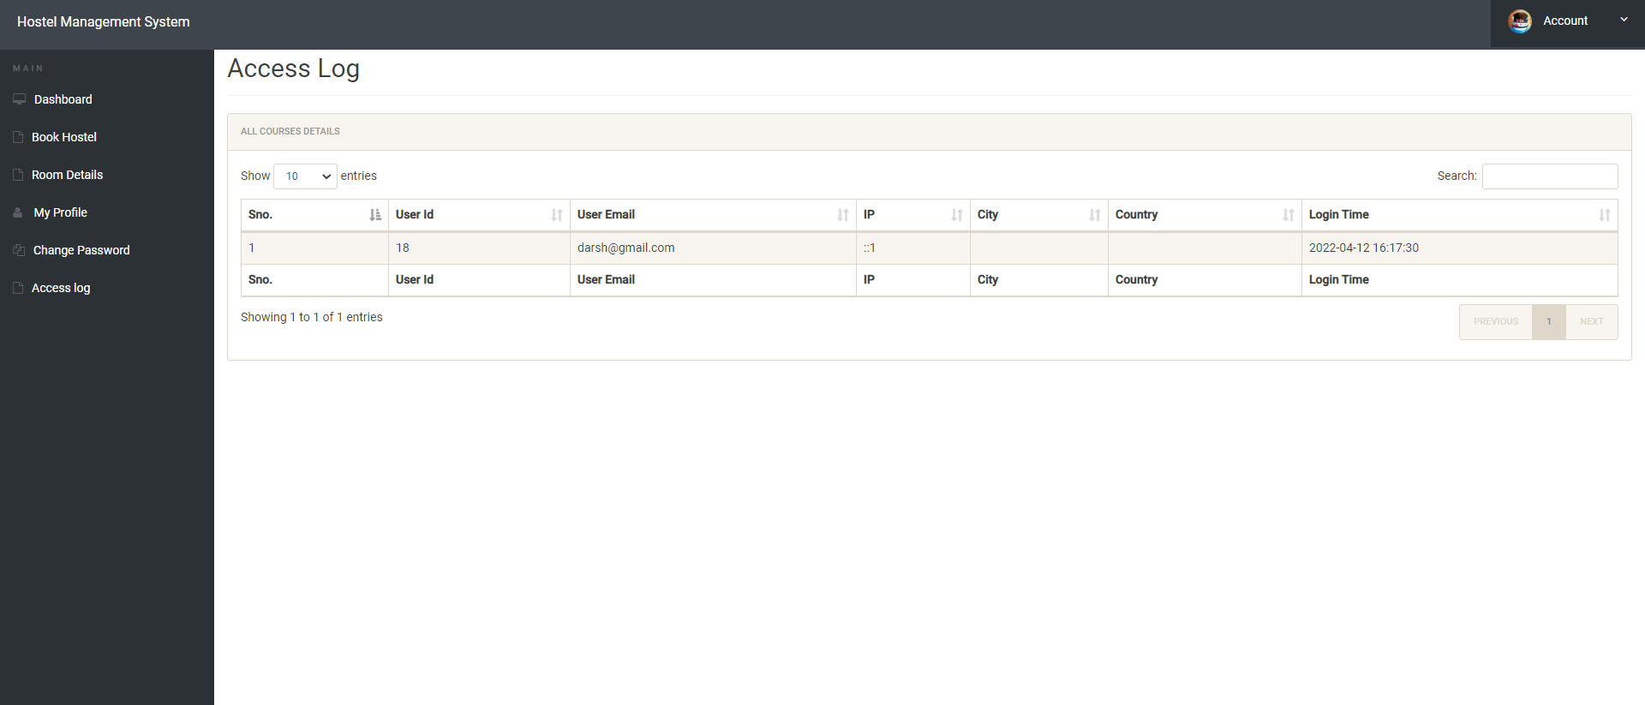
USERS ACCESS LOGS:

Slide 23
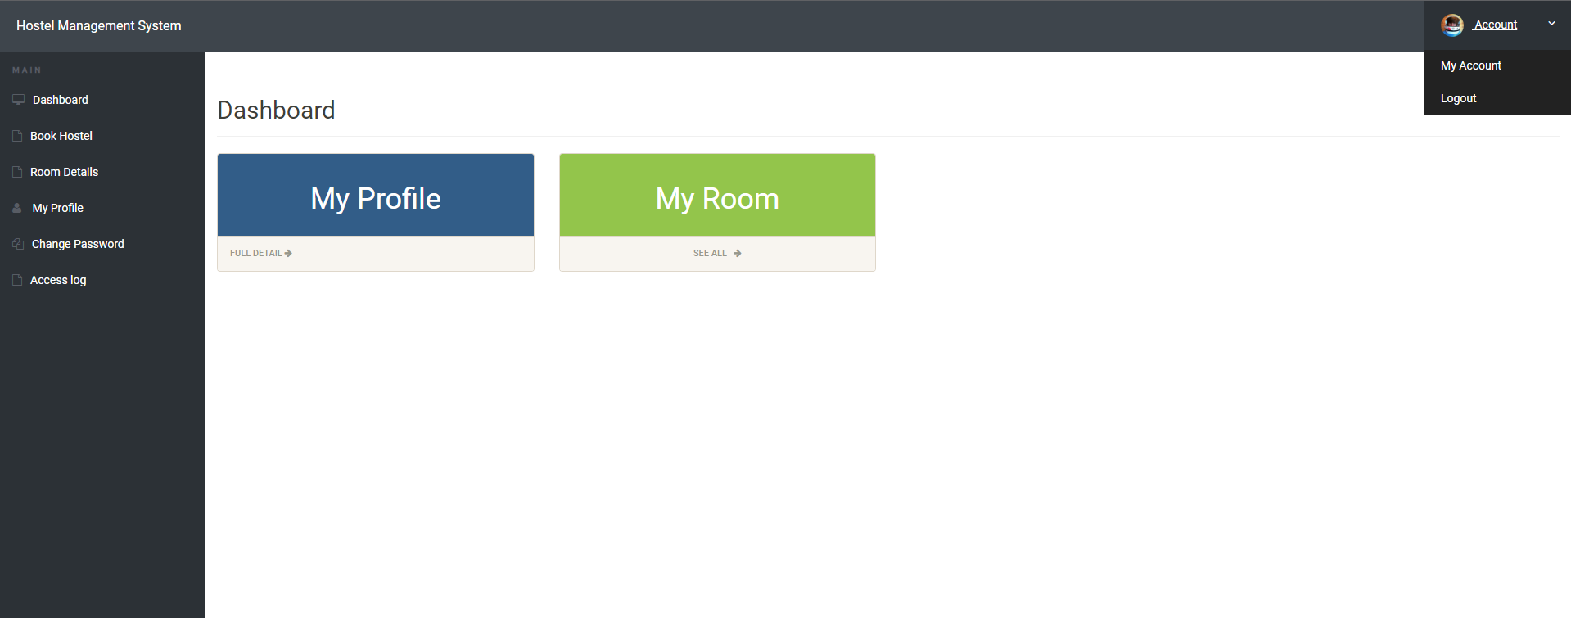
LOGOUT BUTTON :

Slide 24
THANK YOU

